Slide 1
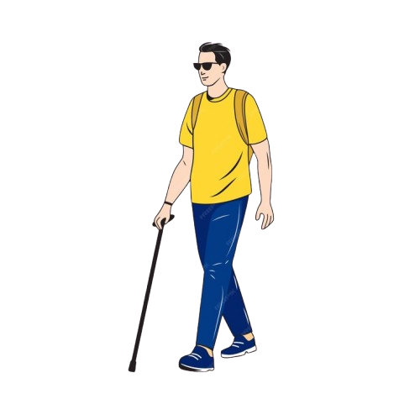
Smart Blind Stick for Blind people

Slide 2
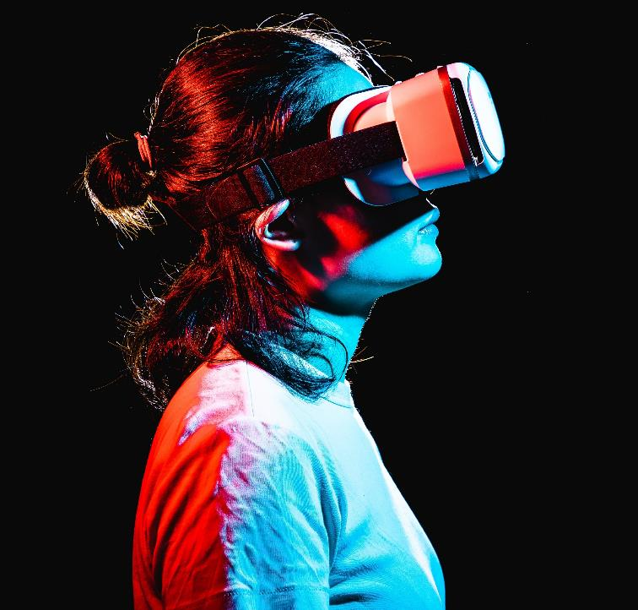
About us
Md. Asifur Rahman
Dept: IIT
Insana Akhi
Dept: IRS & GIS
Sadia Sultana
Dept: IRS & GIS

Slide 3
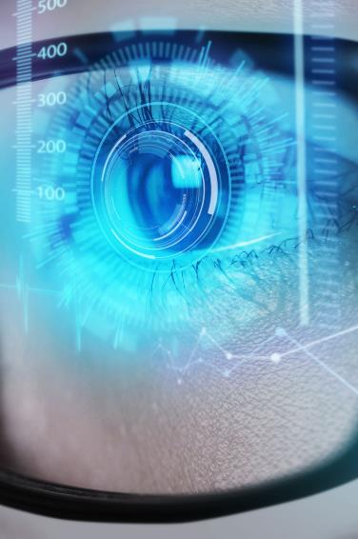
Project Objective
To design and develop a Smart Blind Stick that assists visually impaired individuals with mobility, safety, and independence. The device will integrate several innovative features to improve the overall quality of life for blind users.

Slide 4
Solution
Close the gap
Target audience
Our product makes managing tasks easier, and no other product on the market offers the same benefits
Blind People
Cost savings
Easy to use
Reduce costs for client by helping project managers stay on target within deadlines
A simple product that gives handy Usability to the blind.

Slide 5


Project Features
Find the Stick with Remote Sound Locator
Obstacle
Detection
Water
Detection
One of the common problems faced by blind people is losing their walking stick. This feature integrates a remote device that can help the blind individual locate the stick easily by emitting a distinct sound when activated.
The smart stick will be equipped with ultrasonic or infrared sensors to detect obstacles in the user’s path while they are walking.
The smart stick will be equipped with Water sensor to detect Water in the user’s path while they are walking.

Slide 6
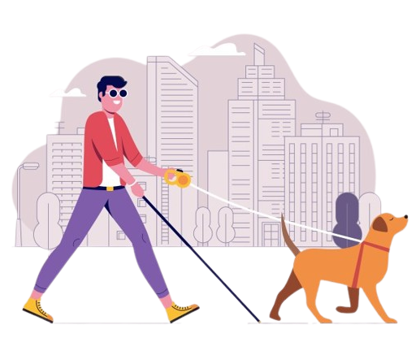
Expected Impact
Increased Mobility​
Safety Assurance​
Improved Quality of Life​​

Slide 7
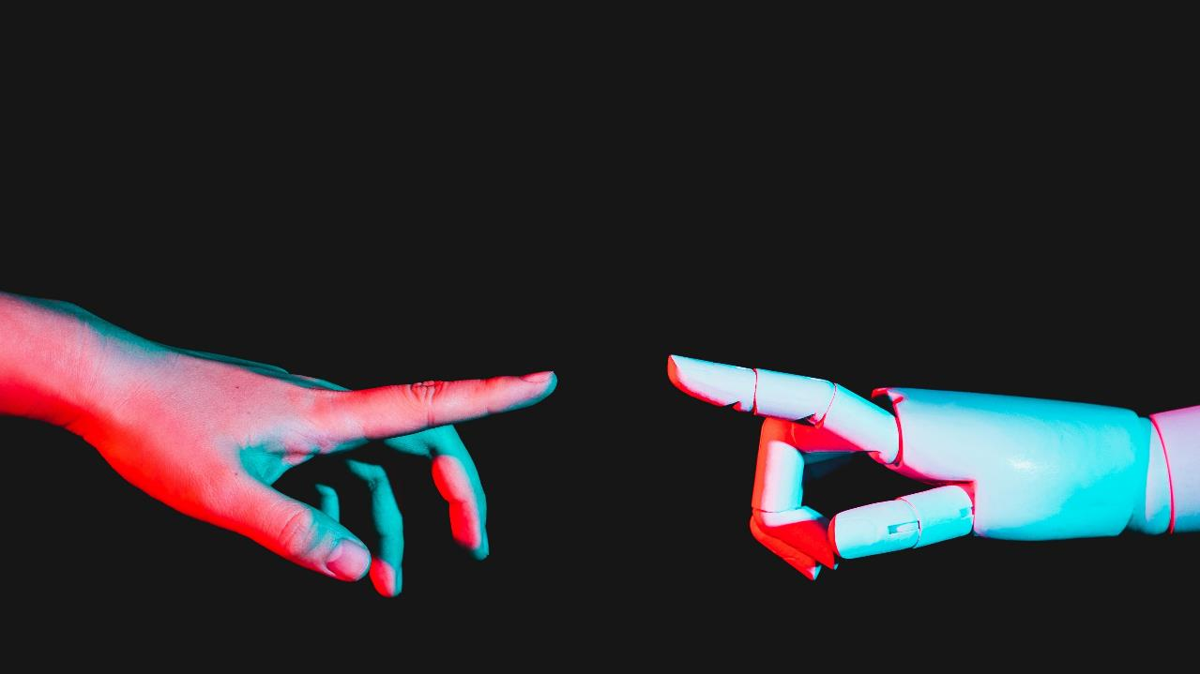
project Demonstration

Slide 8
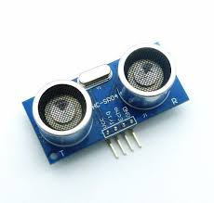
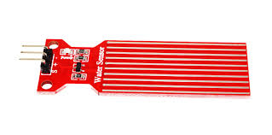
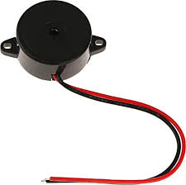
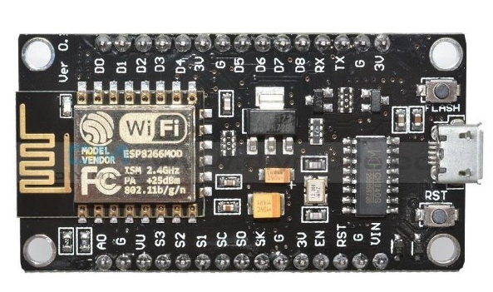
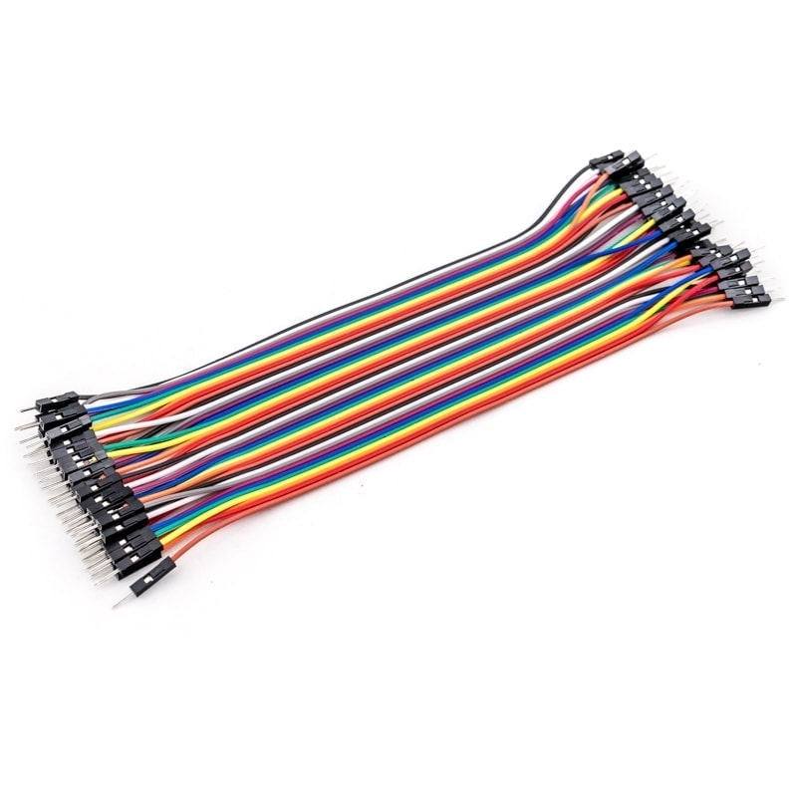
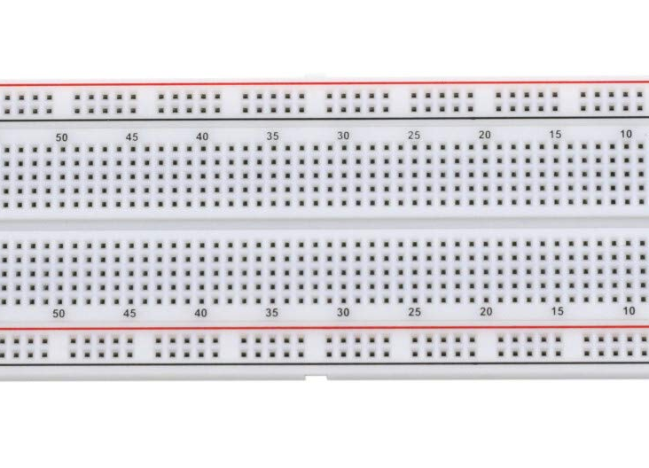

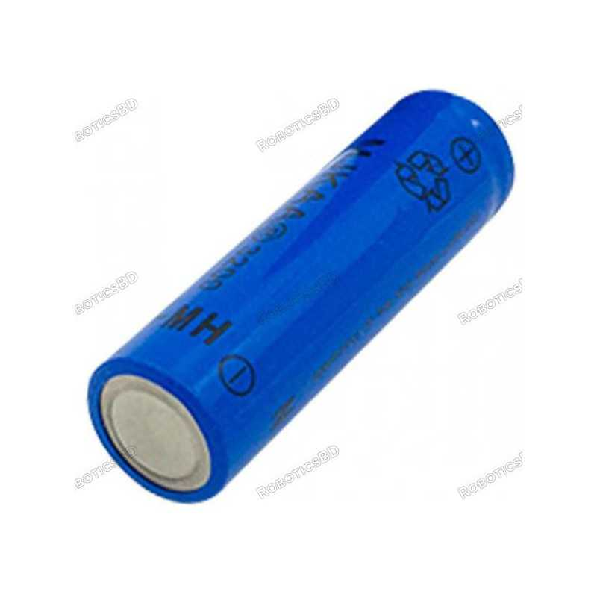
Technologies Involved
Ultrasonic Sensor​
Water Sensor​​
Buzzar​​
Rajesh Santoshi​​
VP Marketing​
Jump wire
breadboard​
Blynk app​
Battary​

Slide 9
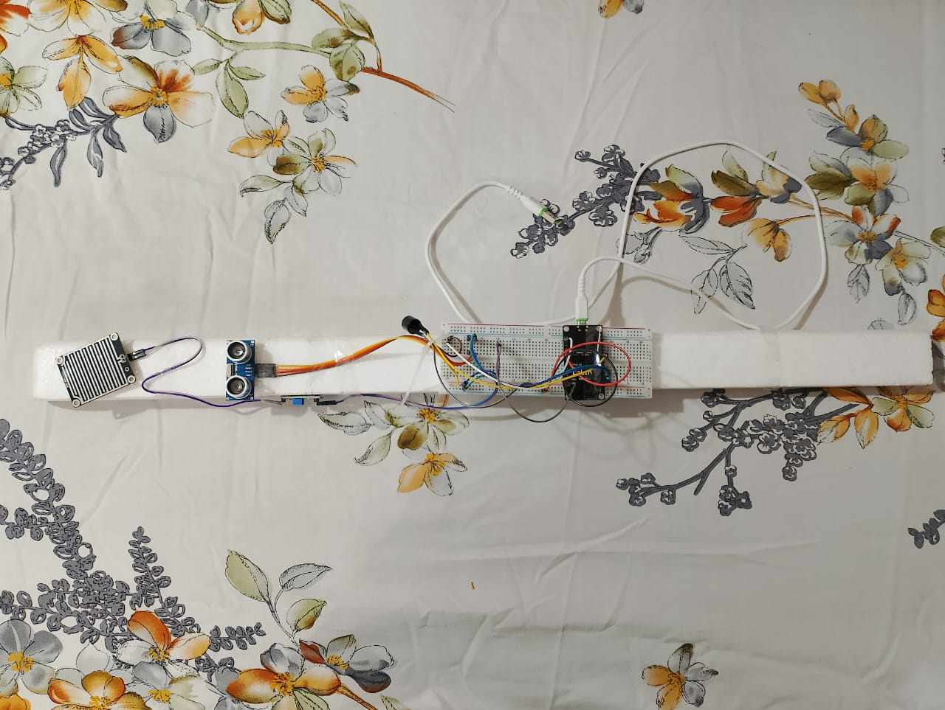
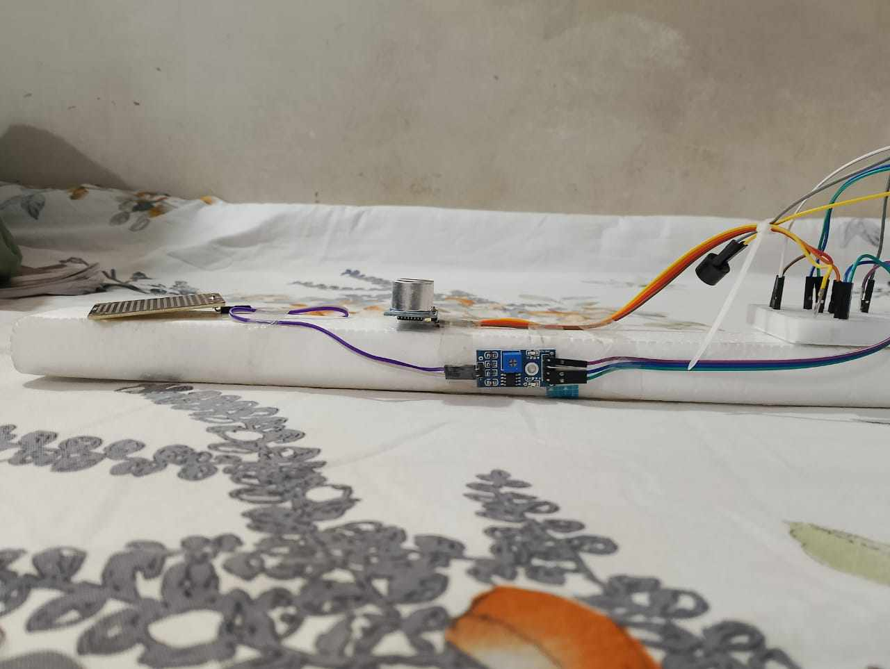
Project Picture

Slide 10
The End

